Slide 1
Balancing Robot
Phase 1: Closed Loop balance and driving

Slide 2
Project Overview
Two-Wheel Self-Balancing Robot
Autonomous two-wheel robot modeled as an inverted pendulum
Maintains an upright position by continuously correcting wheel motion
Uses body-angle and wheel-motion feedback for closed-loop control
Designed as a modular platform for:
  Balance-control development
  Sensor integration
  Motor-control testing
  Future autonomous navigation

Slide 4
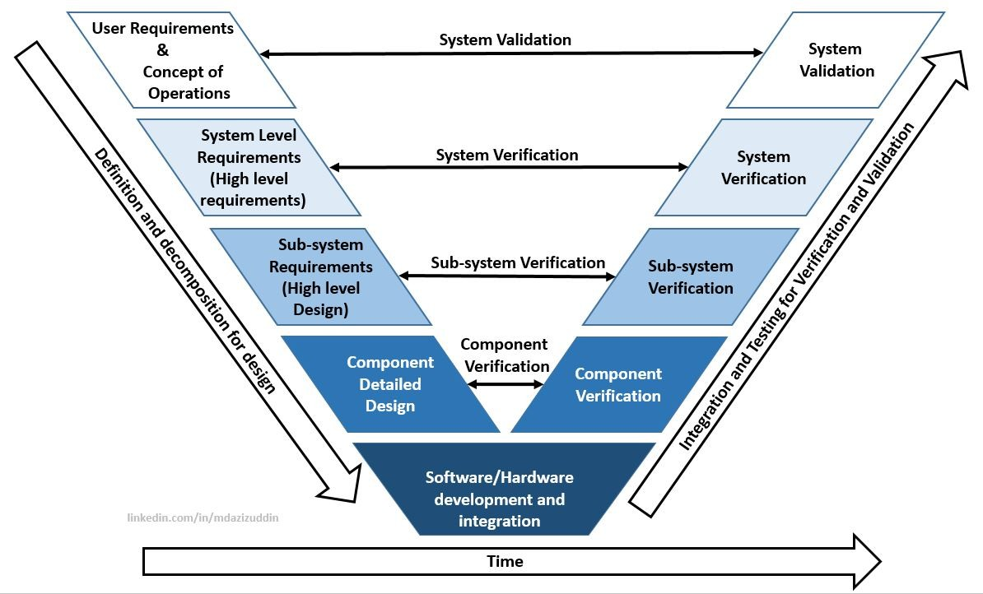

Slide 5
Design
Definition & Decomposition

Slide 6
Concept & Requirements
Two-wheel differential-drive balancing robot
Tires: 110 mm diameter × 45 mm wide
Motors: Pololu 37D 131:1 12V encoder gearmotors
Motor drivers: Pololu G2 High-Power Motor Driver 18v17
Controller: Teensy 4.1
Power: 3S 11.1V LiPo battery
Logic supply: Pololu D24V90F5 5V, 9A regulator
Primary balance sensor: MPU-9250 / MPU-6500 IMU
Future distance sensor: VL53L0X ToF sensor
Design intent:
  High torque over high speed
  Stable low-speed balancing
  Modular electronics for testing
  Easy access to wiring, USB, battery, and motor drivers

Slide 7
System Level Requirements
Robot shall balance upright on two wheels without external support.
Robot shall estimate pitch angle and pitch rate in real time.
Robot shall drive both wheels independently for balance correction.
Robot shall use encoder feedback from both motors.
Robot shall operate from a 3S LiPo battery.
Robot shall protect Teensy I/O from voltages above 3.3V.
Robot shall have a common electrical ground between battery, motor drivers, regulator, Teensy, IMU, and encoders.
Robot shall include a safe power switch or disconnect.
Robot shall be mechanically wide enough to prevent side tipping during tuning.
Robot shall keep mass centered left-to-right and near the wheel axle plane front-to-back.

Slide 8
Sub-system Level Requirements
Mechanical
Use two 110 mm diameter × 45 mm wide tires.
Target overall outside wheel width: ~230–260 mm TBD
Target motor center-to-center spacing: ~185–215 mm TBD
Frame shall hold motors rigidly and symmetrically.
IMU shall be mounted rigidly to the frame.
Battery shall be mounted securely near centerline.
Electronics shall be protected but accessible during testing.

Slide 9
Sub-system Level Requirements
Power
3S LiPo shall feed motor drivers directly.
D24V90F5 shall regulate battery voltage to 5V.
Teensy shall be powered from regulated 5V.
IMU and sensors shall use 3.3V-compatible logic only.
Add bulk capacitance near motor-driver/battery input.
Include fuse, switch, or removable battery plug for safety.

Slide 10
Sub-system Level Requirements
Motor / Driver
One Pololu G2 18v17 motor driver per motor.
Drivers shall receive PWM/direction commands from Teensy.
Drivers shall share ground with Teensy.
Motor wiring shall be kept short and separated from IMU wiring where possible.

Slide 11
Sub-system Level Requirements
Encoder
Quadrature encoder outputs shall connect to interrupt-capable Teensy pins.
Encoder logic voltage shall be limited to 3.3V or level shifted.
Encoder feedback shall support wheel speed and position estimation.

Slide 12
Sub-system Level Requirements
IMU
IMU shall communicate over I2C.
I2C pullups shall go to 3.3V only.
IMU pitch axis shall align with robot forward/backward tipping motion.
IMU orientation shall be verified before PID tuning.

Slide 13
Sub-system Level Requirements
Software / Controls
Read raw accelerometer and gyroscope data.
Calculate pitch from accelerometer.
Integrate gyro pitch rate.
Use complementary filter or Kalman-style fusion.
Balance controller shall command motor torque/speed based on pitch error.
Add serial debug output for pitch, gyro rate, encoder speed, and motor command.

Slide 14
Component Detailed Design
Controller: Teensy 4.1, 3.3V logic, high-speed control loop
Motors: 2× Pololu 37D 131:1 12V encoder gearmotors
Drivers: 2× Pololu G2 18v17, one per motor
Wheels: 110 mm diameter × 45 mm wide tires
Battery: 3S 11.1V LiPo
Regulator: Pololu D24V90F5 5V, 9A step-down
IMU: MPU-9250 / MPU-6500 over I2C
Distance sensor: VL53L0X ToF, future navigation/obstacle sensing
Frame: rigid test chassis first, final CAD chassis after electronics validation
Safety components: switch/disconnect, common ground, bulk capacitors, strain relief, protected wiring

Slide 15
Integration & Testing
Verification and Validation

Slide 16
Component Verification

Slide 17
Sub-system Verification

Slide 18
System Verification

Slide 19
System Validation

